Slide 1
vMfgSys |
Ver.6.0
Project Management
Inventory
Control
SOFTVENT SERVICES PVT. LTD.
www.softvent.com

Slide 2

CEO MESSAGE
“ On Behalf of everyone at Softvent Services Pvt. Ltd., would like to thank you for being our Customer.
We value the trust you have put in our Products and Services and would like to Thank You For that.
It's always a pleasure serving you and we certainly look forward to doing that in the future.
Your feedback is very important as we are constantly looking for ways to improve our Product and Services. ”
www.softvent.com

Slide 3
Content
Introduction
Key Features/Benefits
www.softvent.com

Slide 4
Introduction of vMfgSys
www.softvent.com

Slide 5
Key Features/Benefits
Home Page
Logins
Robust Security
Multiple Database connectivity
Dashboard
Data Porting
Highly Developed Interface of Data Entry
Features Enriched Transaction Entry Screen
Alerts and Notifications
Email
SMS
Versatile Searching Feature
Audit Log
Screen Documents
Document Sharing
Data Synchronization
Customized Reports
User wise settings
Supporting Apps
Graphs
Integration to Tally Accounting Software / QuickBooks /
ERP Software's viz. SAP/JD Edwards / LN4 / Navision / Dynamics..
www.softvent.com

Slide 6
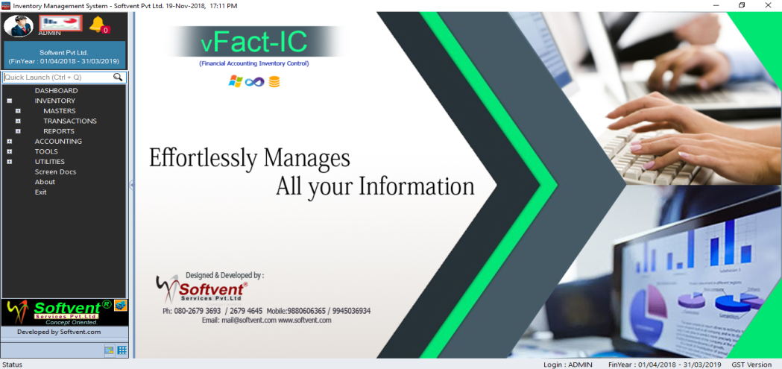
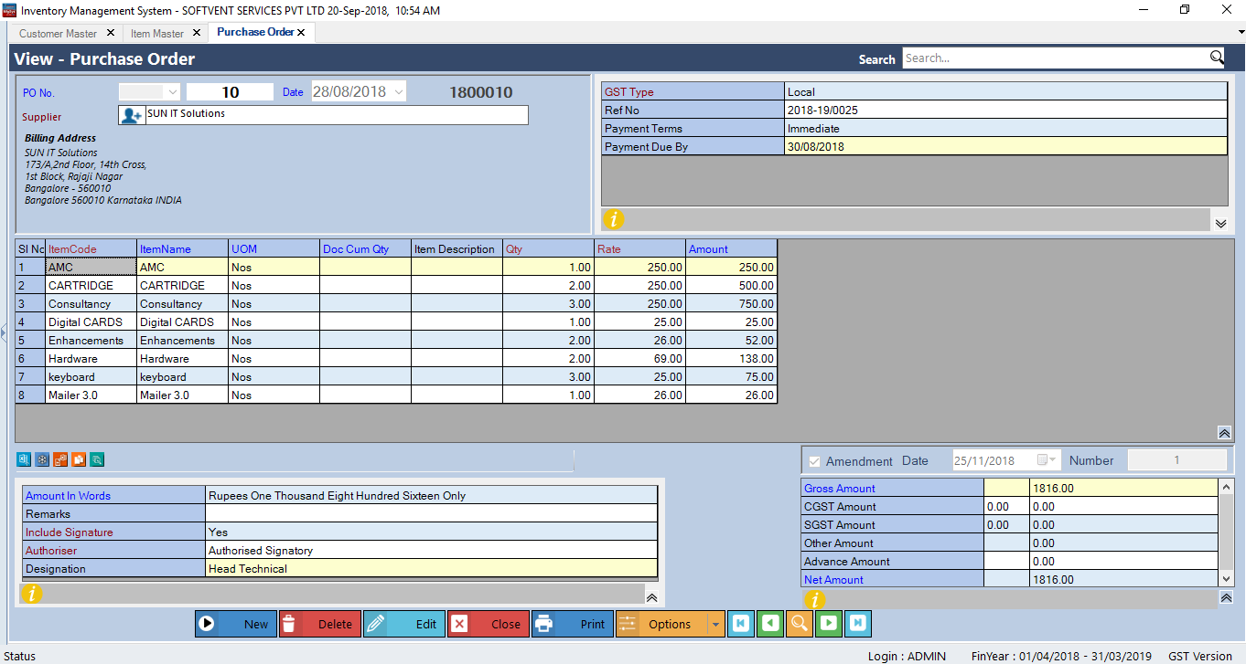
Home Page
Graphical User Interface (GUI)
Tree-view Controlled outlook interface.
ShortCut for Menu Selection
Active screens Toggling done through Tab
Supporting Apps
www.softvent.com
www.softvent.com

Slide 7
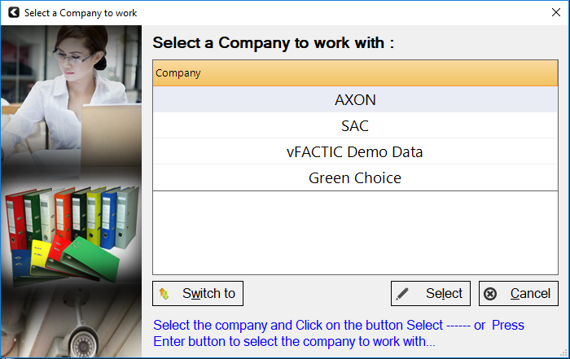
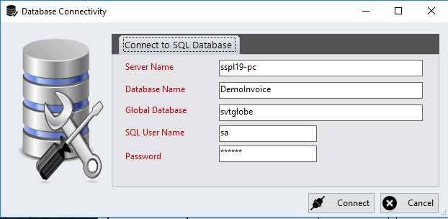
Database
Provision for maintaining more than one Database
www.softvent.com

Slide 8

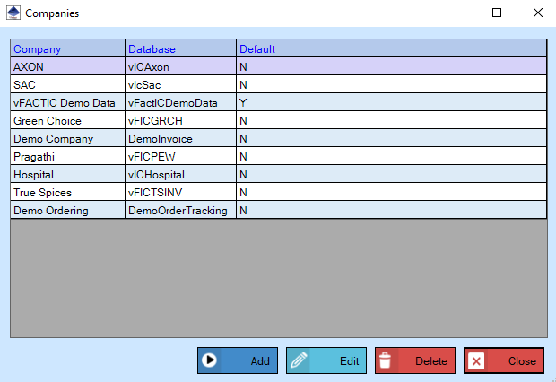
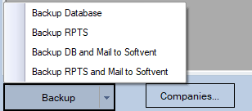
Company Master Info
www.softvent.com

Slide 9
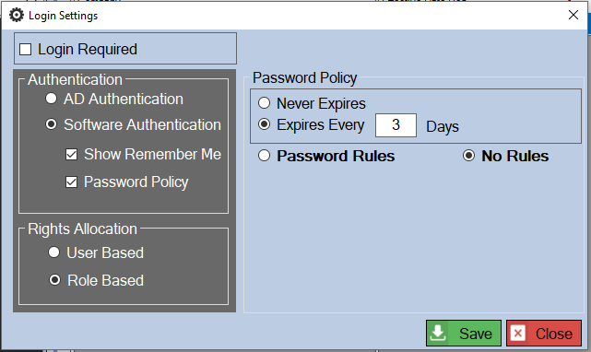
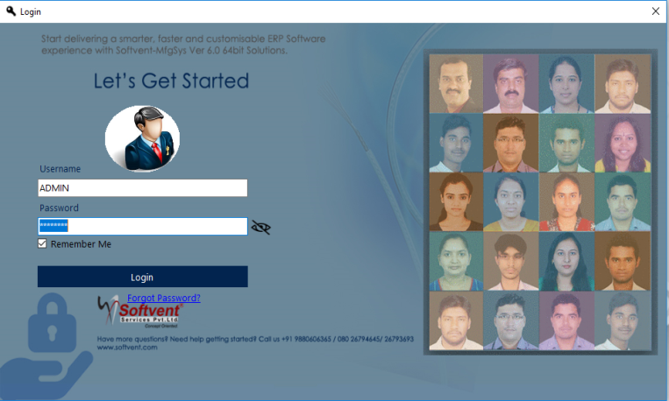
Logins
Provision for different types of Logins
AD Authentication:
Software Authentication:
User Login Screen >>
www.softvent.com

Slide 10
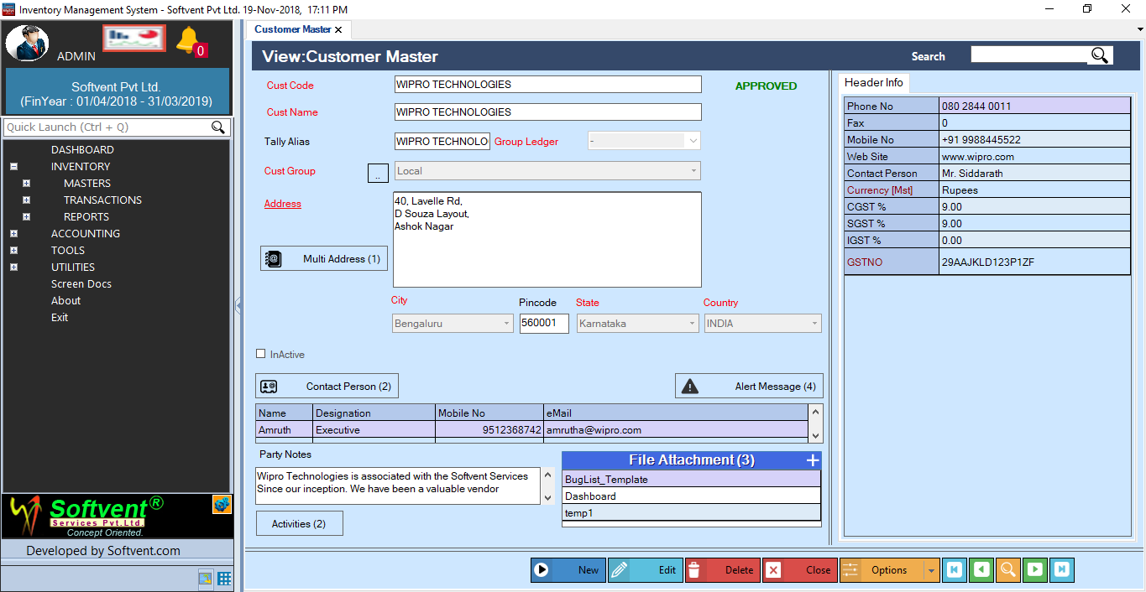
Highly Developed Interface of Data Entry
Master Screen Features
Authorization
Multiple Address
Active/Inactive
Multiple Contact Person Details
Alert Message
Party Notes
Activities
File Attachment
Header Info can be Split in Multiple Tabs
Creation of Fields done using Softvent
DocDesigner Tool
www.softvent.com

Slide 11
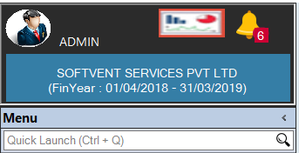
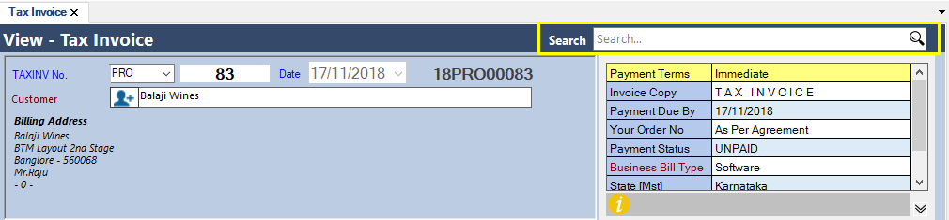
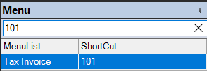
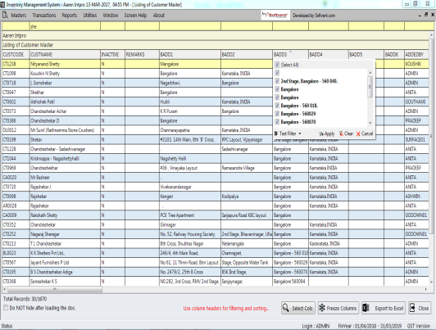
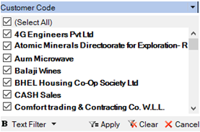
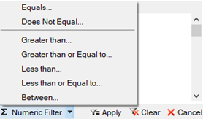
Search
Transpose
Transaction Searching
Menu Searching
ShortCut Menu Searching
Column Header Searching & Sorting
Column Filtering
Actions on the Filtered Data
www.softvent.com

Slide 12
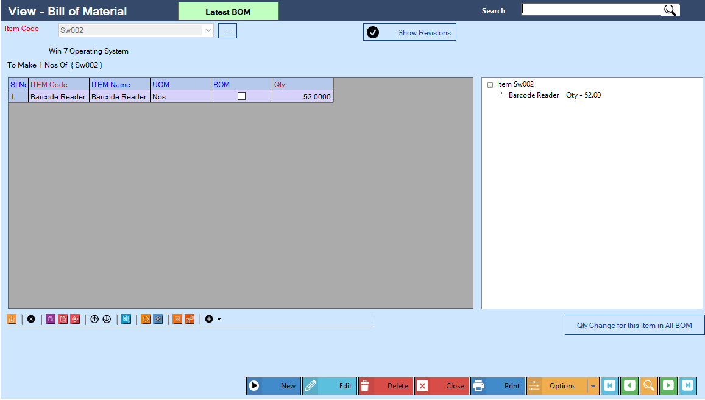

BOM
BOM Screen……..
Bill of Material (BOM)
Items from the inventory table into the BOM with the BOM Designer.
Effectively manage any BOM levels.
Access and reuse previous BOM versions.
Phase out and replace components as needed with effective date Control.
Create quantity-dependent BOMs for end products that require different quantities.
Produce sub-BOMs at multiple sites.
Create phantom BOMs to calculate materials requirements and simplify BOM setup and maintenance.
Include services and items on BOMs.
Show Revision
www.softvent.com

Slide 13
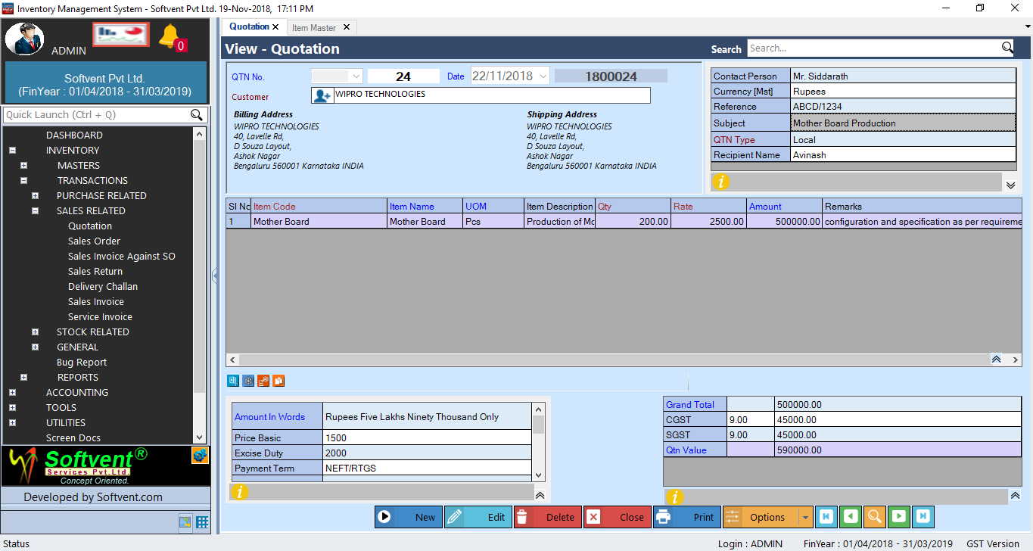
Transaction Screen
Transaction Screen Features
Auto Document number generation
Multiple Print Options
Email / SMS
Authorization
Hdr/Ftr/Tot Sections Info can be Split in Multiple Tab
Actions Performed in Detail Section
Insert
Remove
Copy
Paste
Replace Rest
Move Up
Move Down
XL Export
Attachment
Restore
Freeze/UnFreeze
Add List Of Items
Doc XL Export
Insert Doc
Additional Actions (if any)
Security Options for each controls
Add, Edit, Delete,…
www.softvent.com

Slide 14
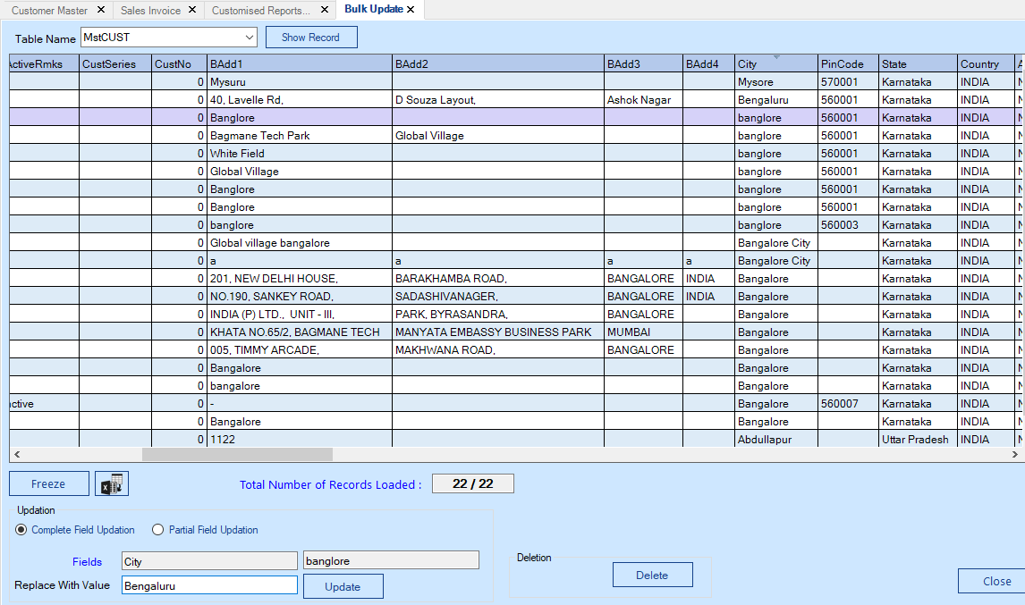
Tools & Utilities
Bulk Update : This Screen will be useful where data can be multiple updation on one go will be made simple.
For Example City in the Data Bangalore can be change to Bengaluru in One Go. Similarly Mgr for Designation can be change to Manager …etc
www.softvent.com

Slide 15
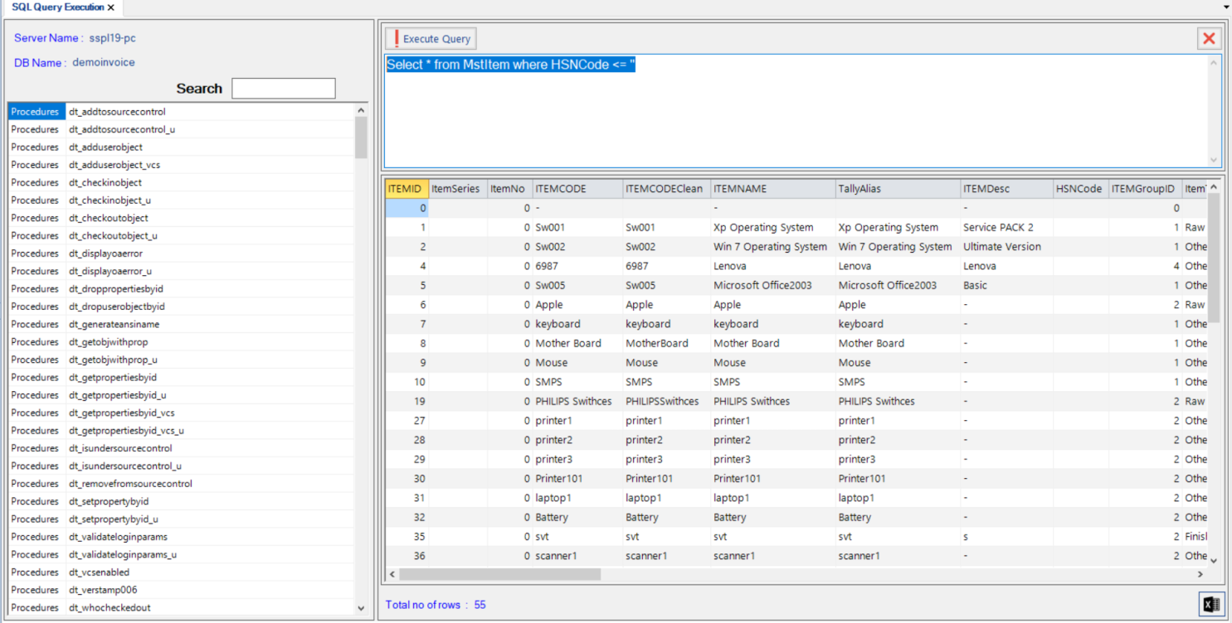
Tools & Utilities
Query Execution Screen
Query Execution : This Screen will help you to write basic / complex queries inorder Generate data from the database, same can be exported to MS Excel
For Example in the Item Master Table Need the Items where HSNCODE not present: to generate the data simple query can be written and executed :
“Select * from MstITEM where HSNCODE <> ‘’”

Slide 16
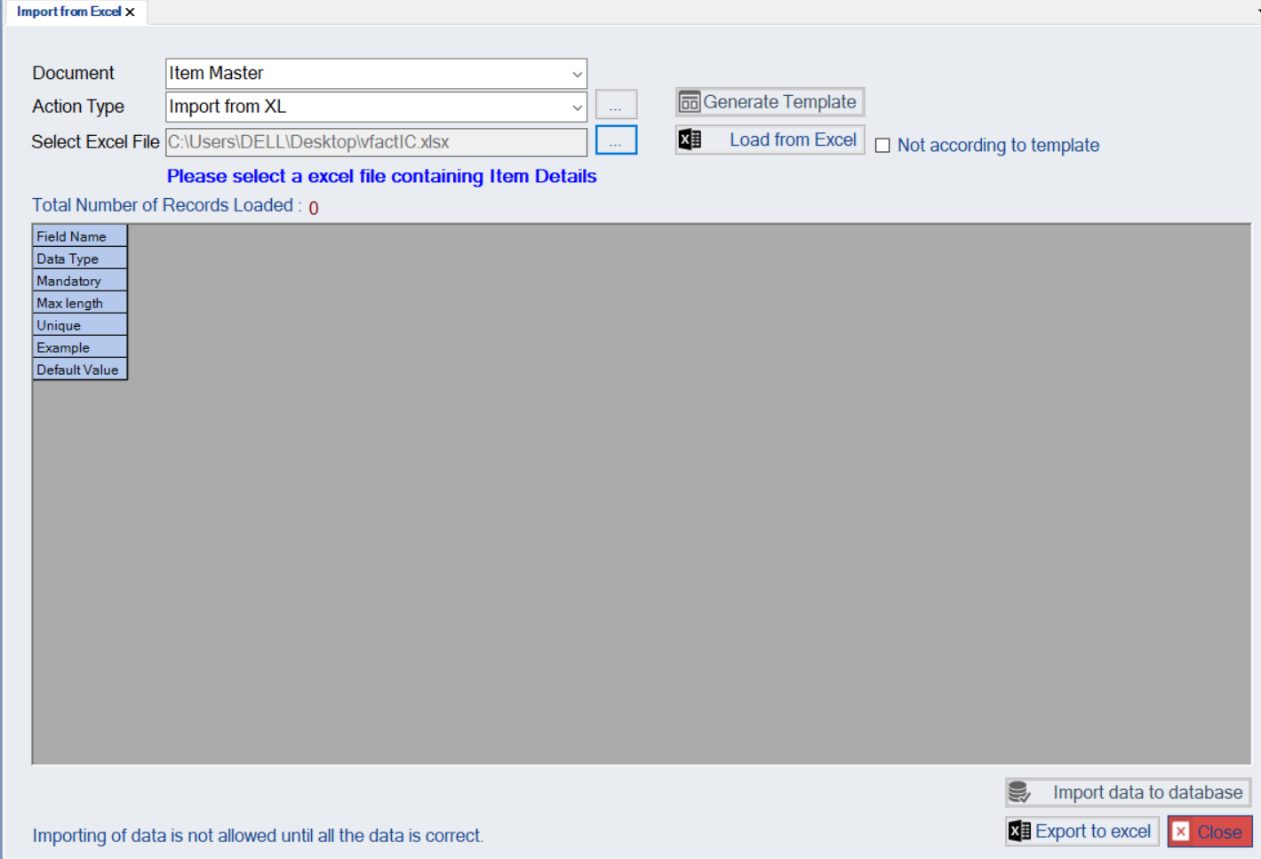
Tools & Utilities
IMPORT Screen
This screen will help you to import the master data from excel sheet.
For Example

Slide 17
Tools & Utilities
POST Doc Entry
Screen shot is missing
POST Doc Entry : This Screen will help you to write basic / complex queries inorder Generate data from the database, same can be exported to MS Excel
For Example
www.softvent.com

Slide 18
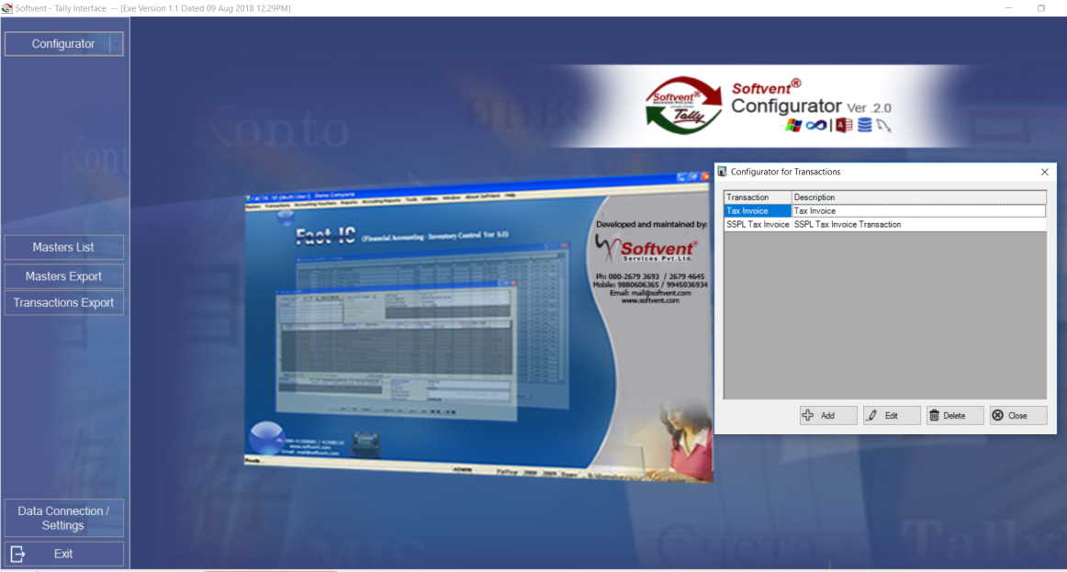
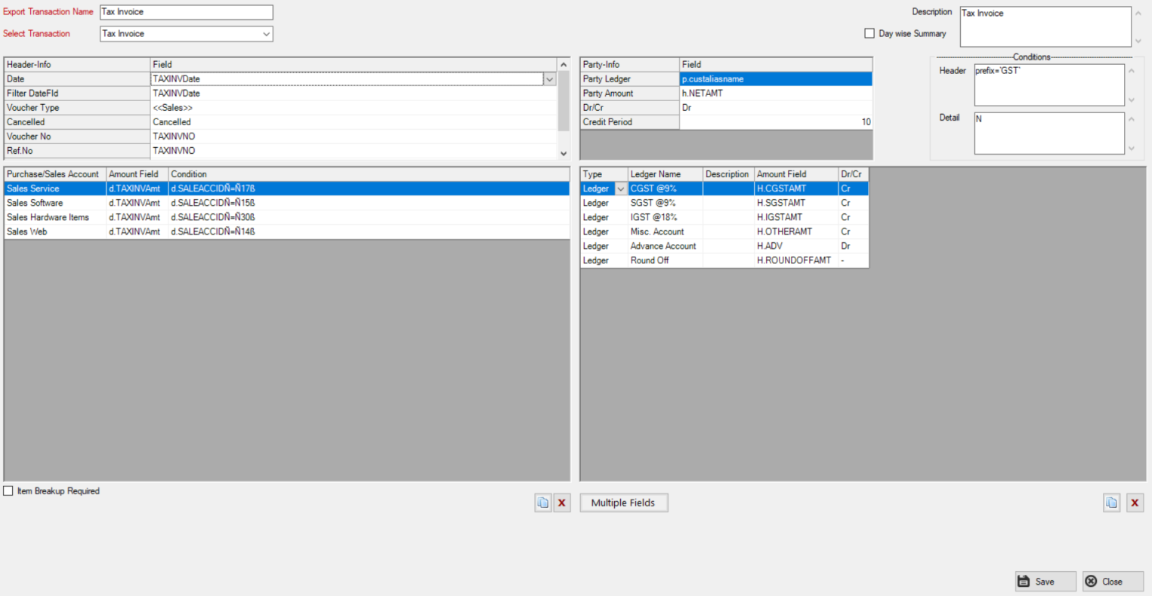
Tools & Utilities
Tally Configurator
This tool will bridge the Data from Mfgsys to Accouting Software. Data Accuracy will be the part

Slide 19
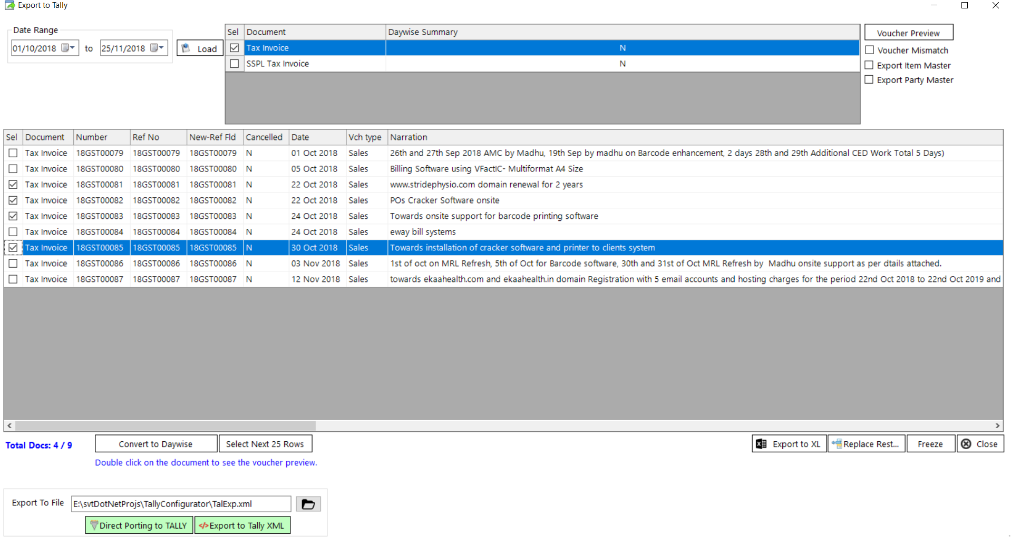
Tools & Utilities
Tally Configurator
Data Exporting Screen

Slide 20
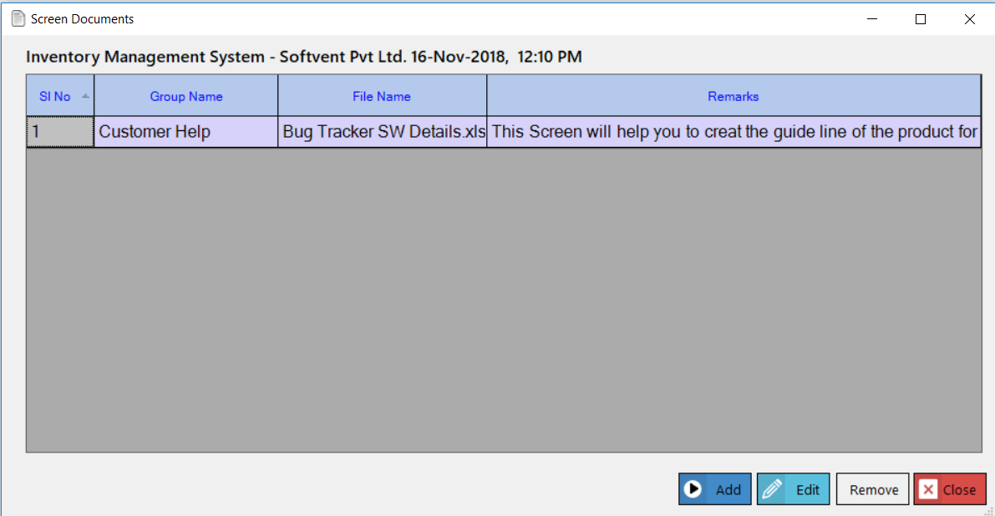
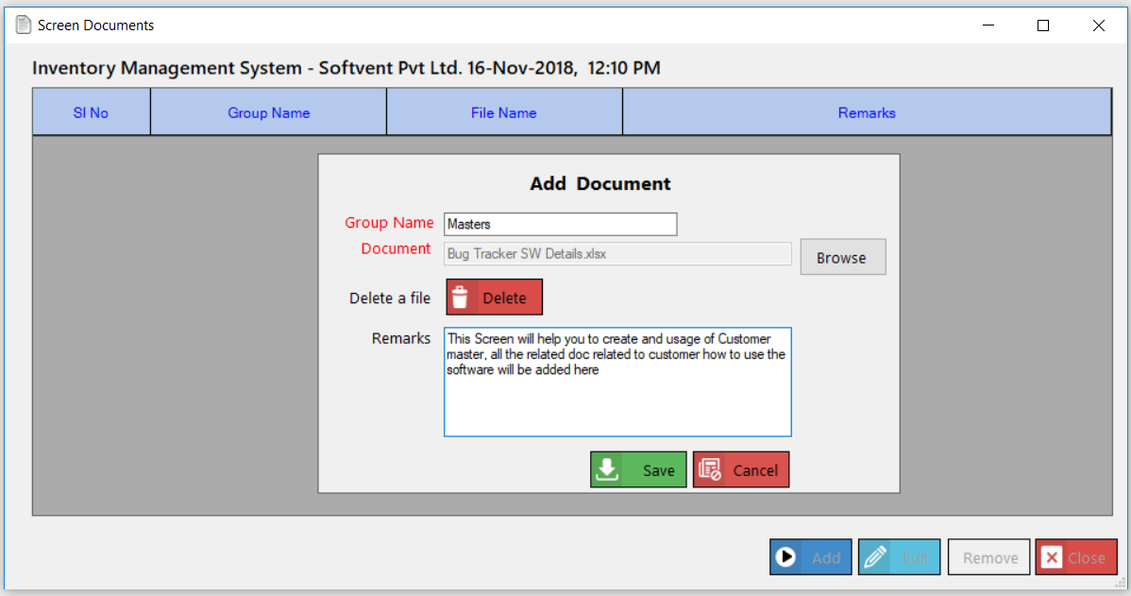
Tools & Utilities
Screen Documents
www.softvent.com

Slide 21
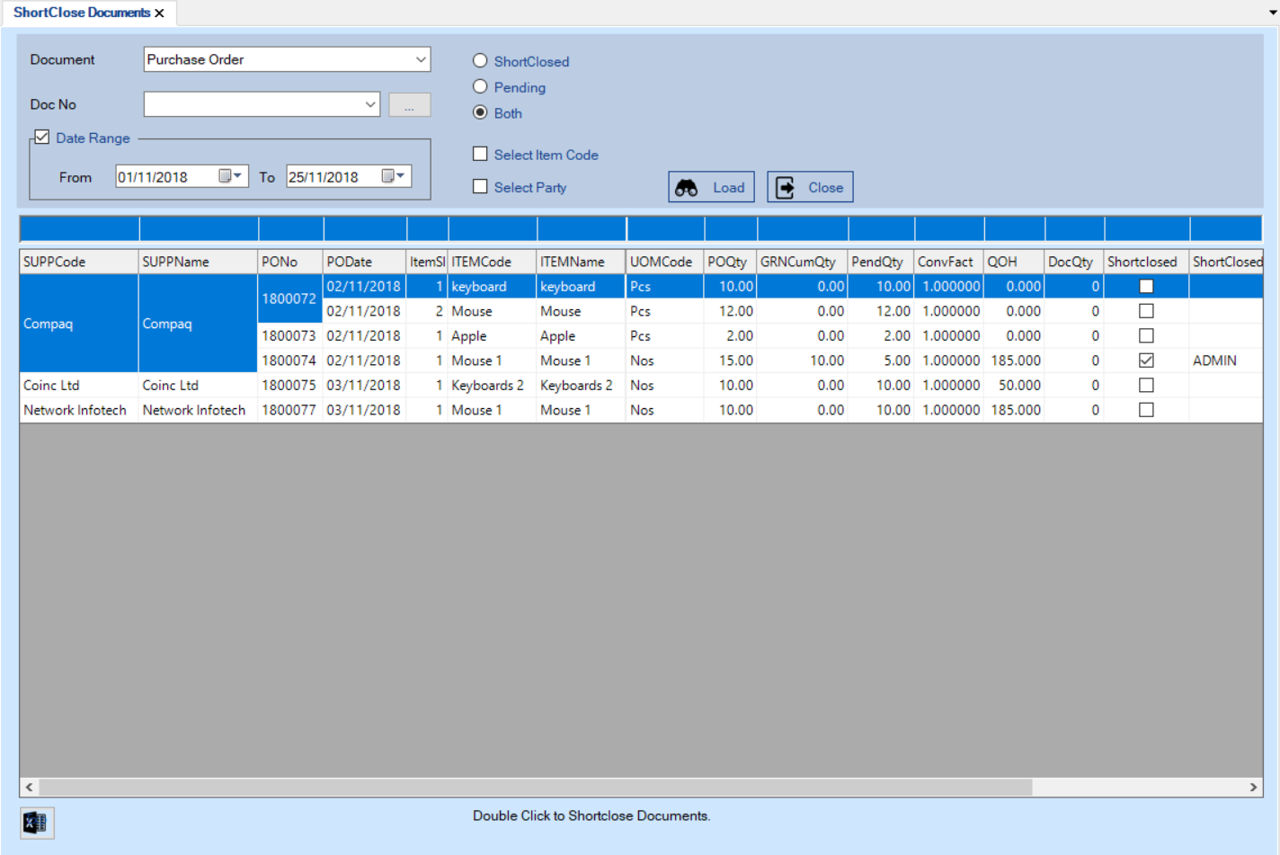
Tools & Utilities
Short Close Screen
Short Close will be helpfull
For Example
www.softvent.com

Slide 22
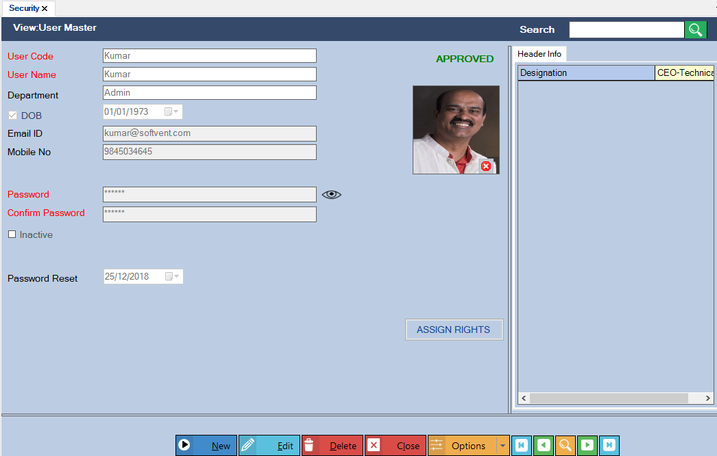
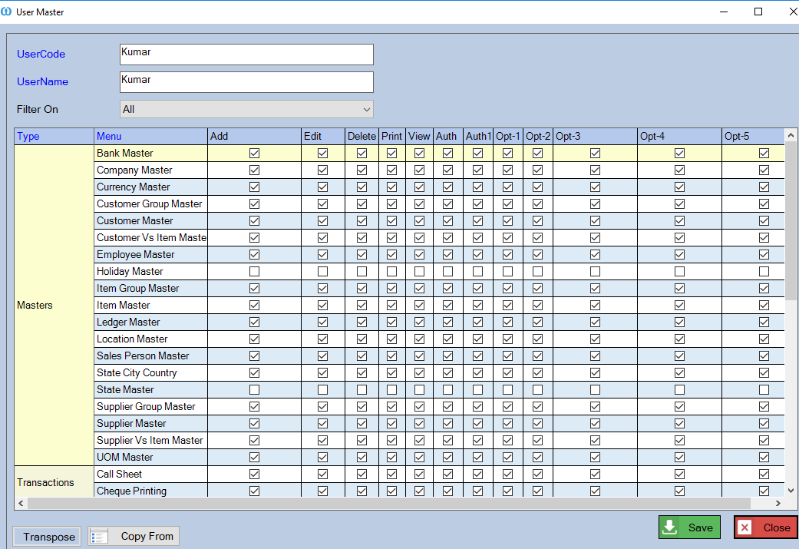
Role Based Security
<< Creation of Users
Assigning of User Rights >>
www.softvent.com

Slide 23
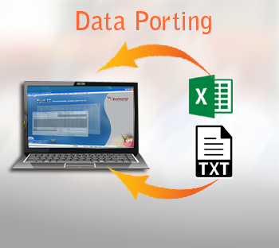
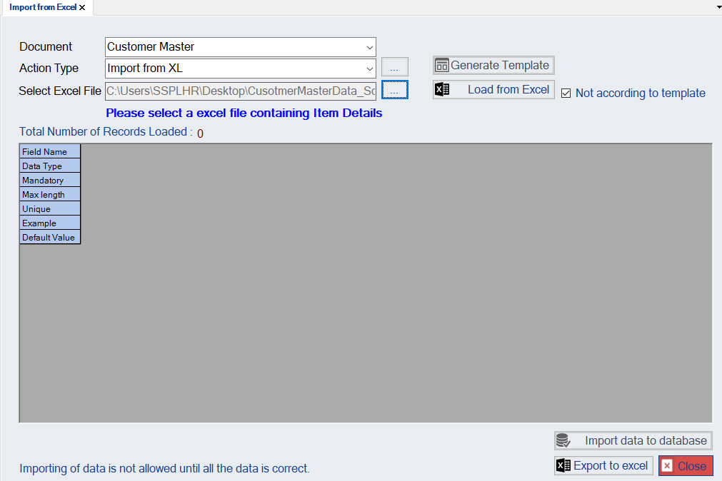
Data Porting
www.softvent.com

Slide 24

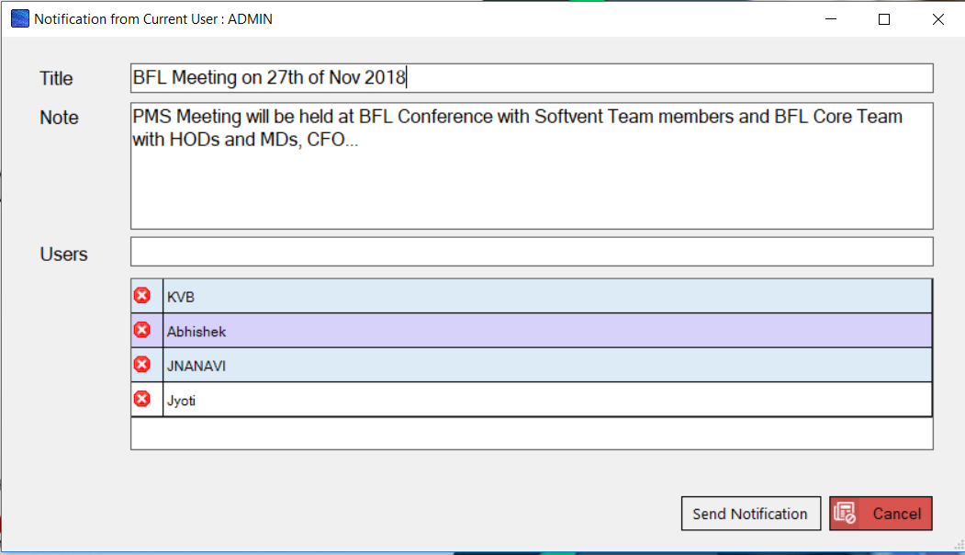
Alerts & Notifications
Notifications
www.softvent.com

Slide 25
E-mail
Send a mail to the person who is supposed to authorize a particular entry Like,
For Instance:
Sales made more than 10lakhs, send email to a particular email id automatically
Send day end sales/purchase/no of qtns…
email to a particular set of email IDS
www.softvent.com

Slide 26
SMS
Integrate with software transactions/reports
For Instance:
Sales made above 10lakhs Rupees, send sms to a particular mobile automatically.
Send day end sales/purchase/no of qtns… sms to a particular mobile
www.softvent.com

Slide 27
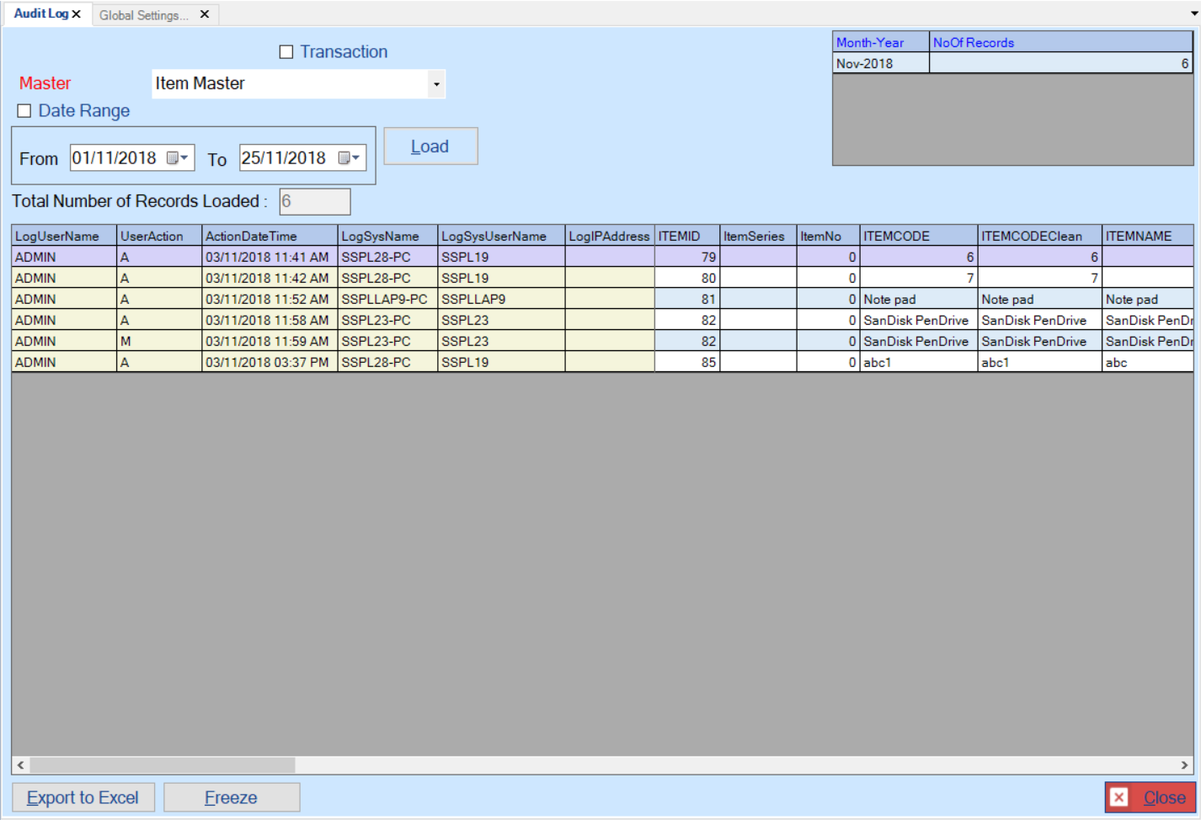
Audit Trial
A robust audit trail is in place, which tracks the following
Which document
Master/Supplier/Purchase order/GRN/Invoice/Qtn …
What action
Added / Updated / Deleted
When
Date and Time
Who
User Name
IP Address of the system
www.softvent.com

Slide 28
Screen Documents
www.softvent.com

Slide 29
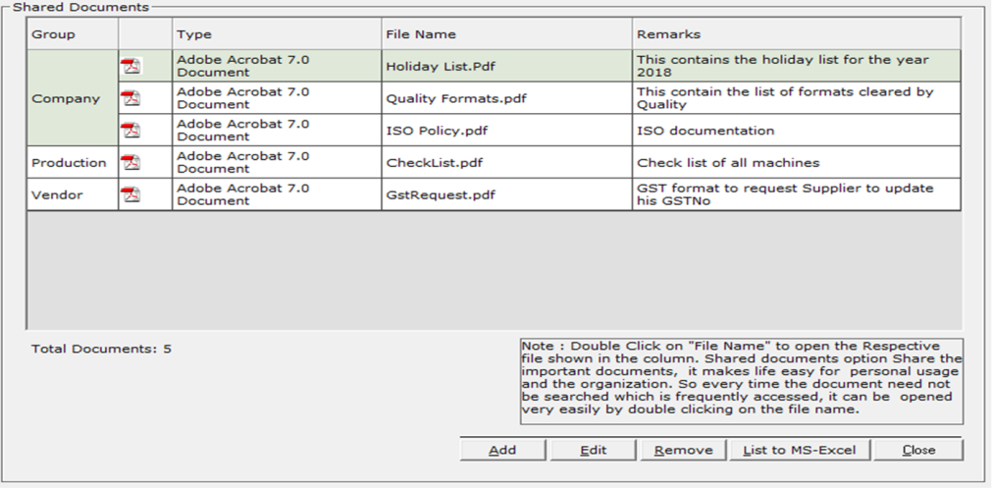
Document Sharing
www.softvent.com

Slide 30
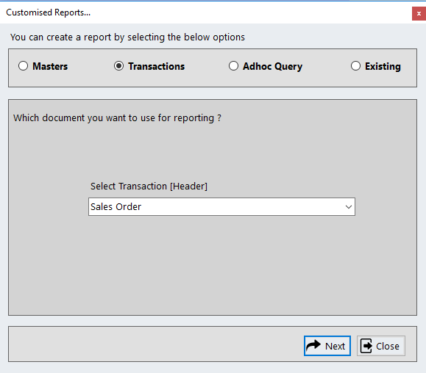
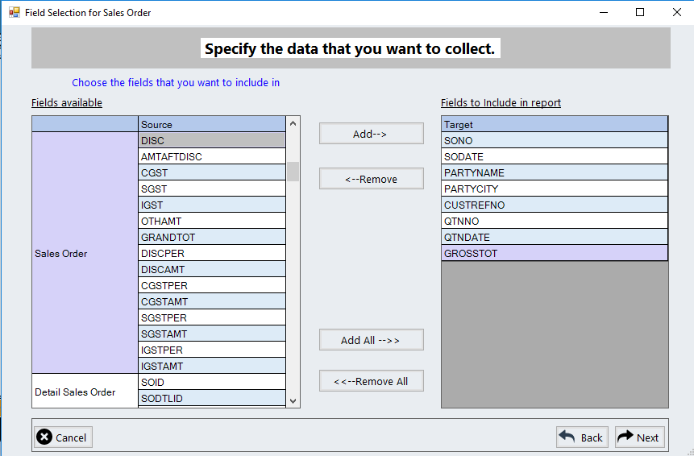
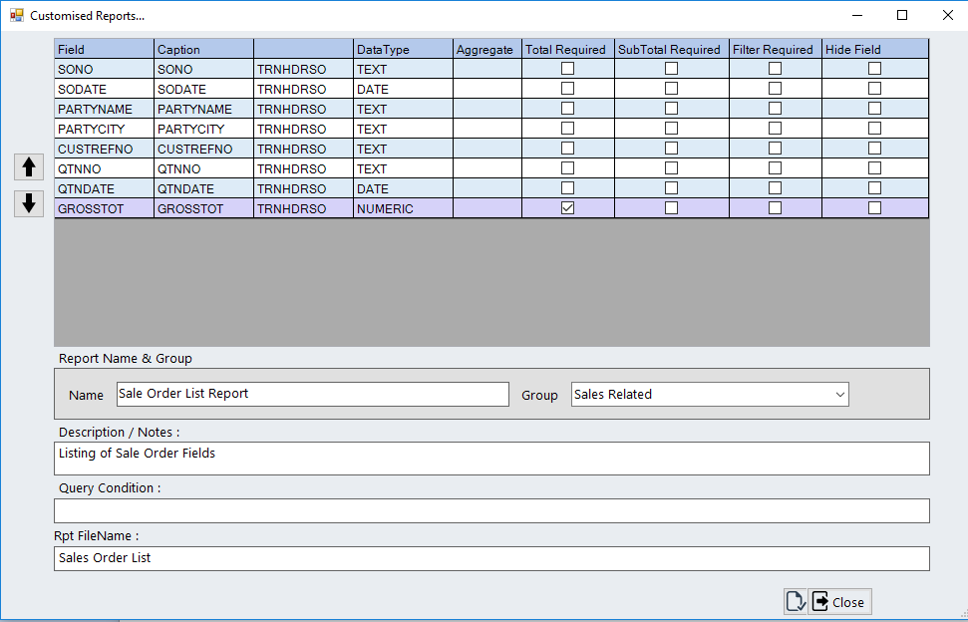
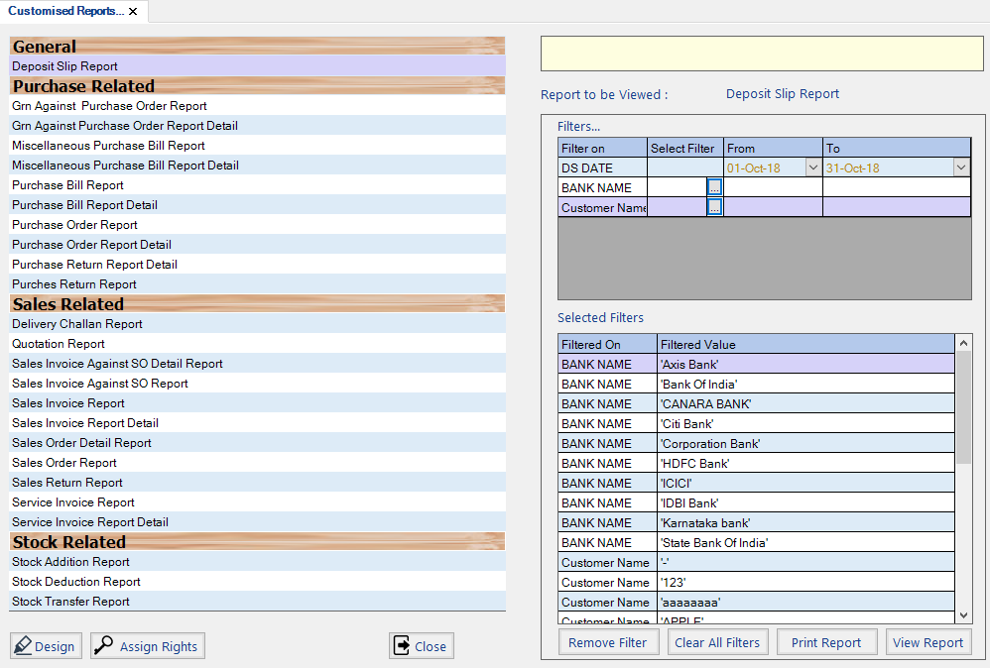
Customized Reports
www.softvent.com

Slide 31
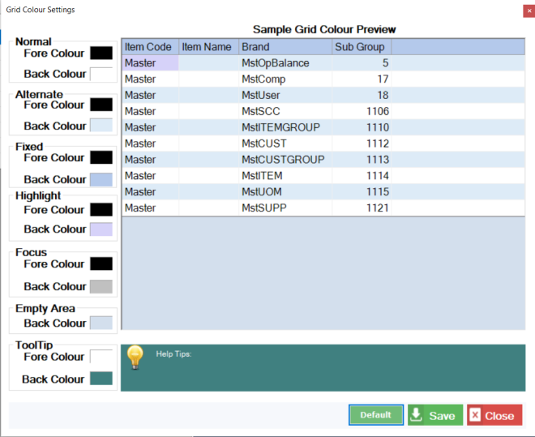
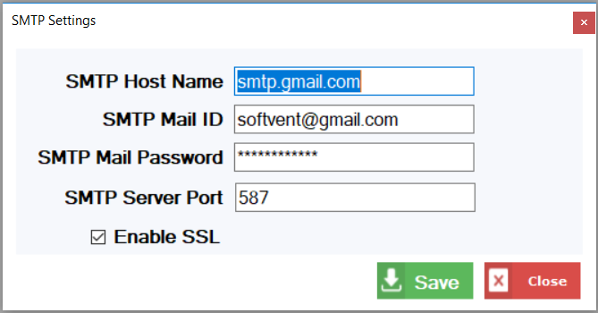
All Settings
Send a mail to the person who is supposed to authorize a particular entry Like,
For Instance:
Sales made more than 10lakhs, send email to a particular email id automatically
Send day end sales/purchase/no of qtns…
email to a particular set of email IDS
www.softvent.com

Slide 32
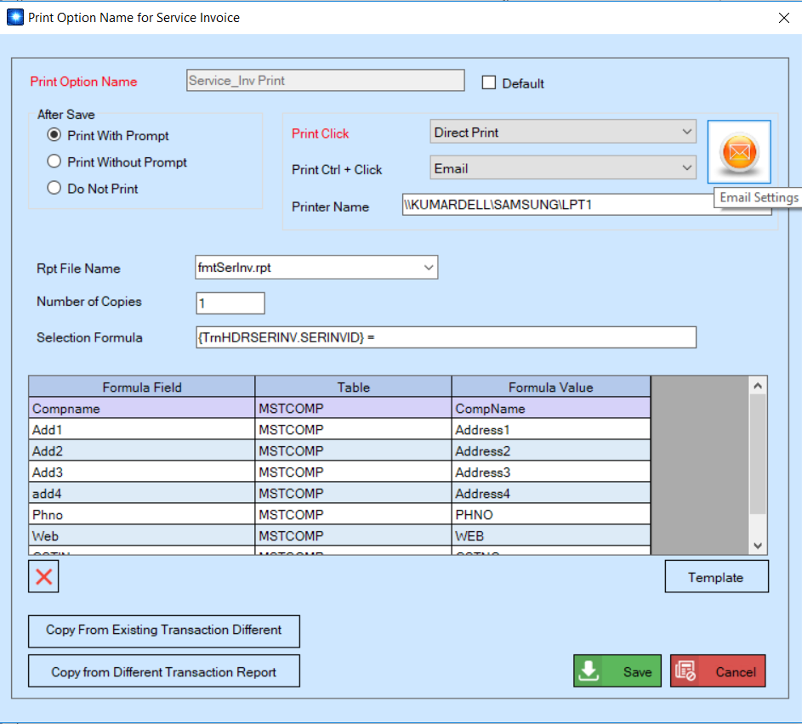
All Settings
www.softvent.com

Slide 33
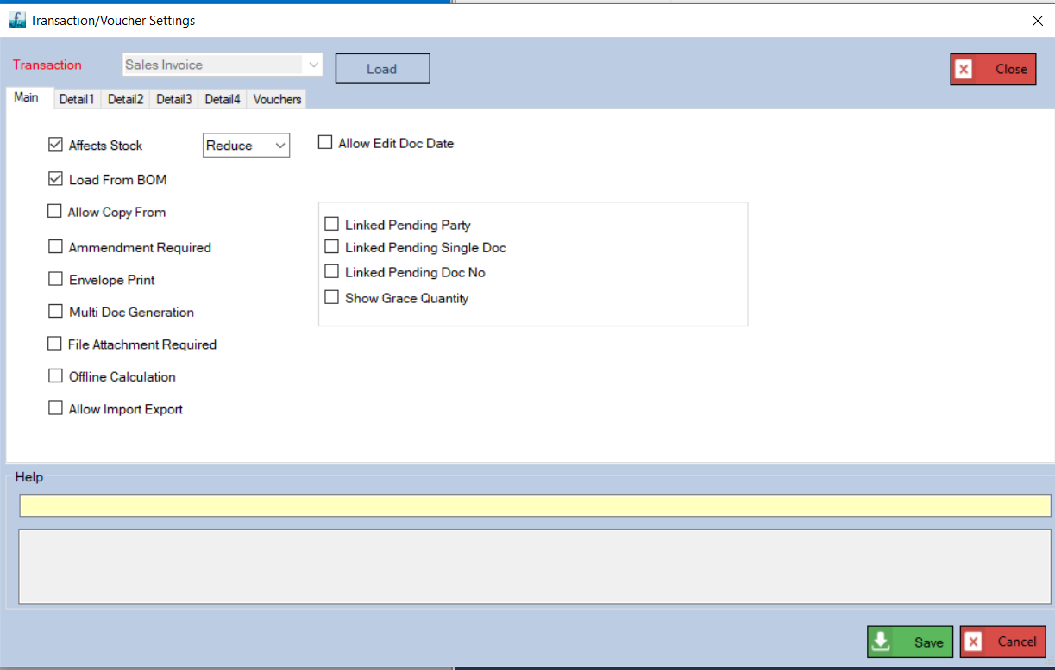
All Settings
www.softvent.com

Slide 34
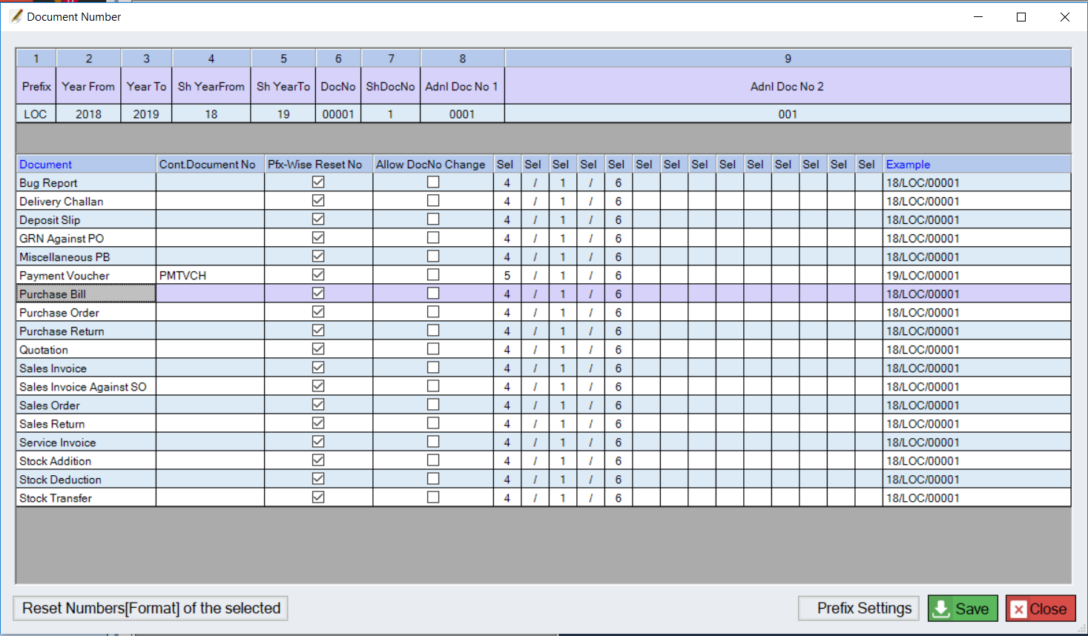
All Settings
www.softvent.com

Slide 35
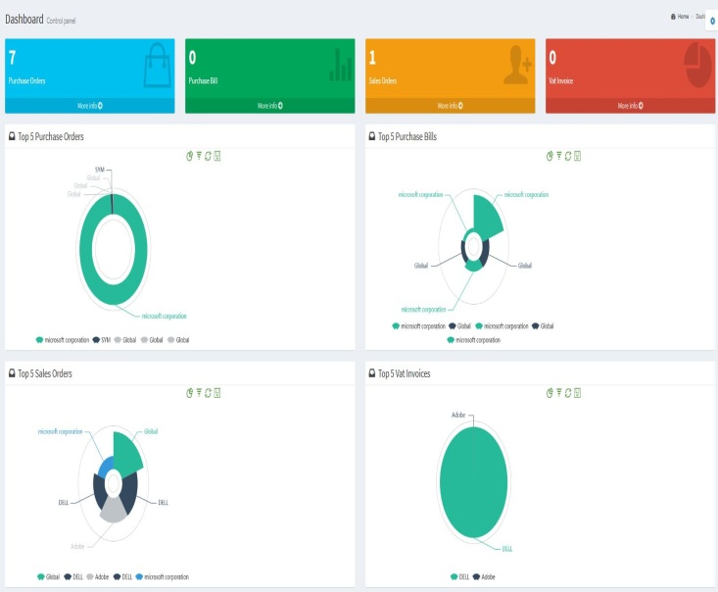
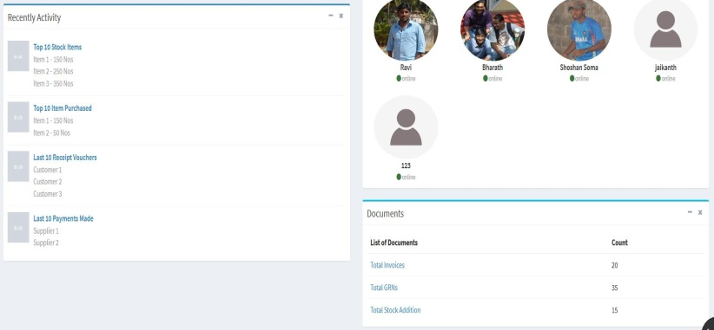
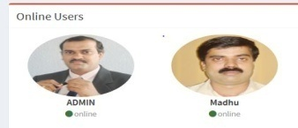
Dashboard
Softvent ERP-MfgSys Dashboard can be totally customised for your business.
The dashboard created serve as a perfect alternative to traditional ERP systems, monitoring your entire business for less.
Can be fully customized to mirror the steady look and feel of your business.
They are created with full access to as many or as few data as desired and, as such, update in real time to display the health of your business in the most up-to-date manner possible.
Graphs
Summary reports
Pending tasks/activities
Organisation level messages/information
Alerts to individual users
www.softvent.com

Slide 36
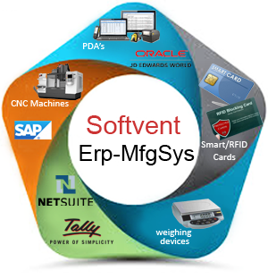
Data Synchronization
Softvent ERP Can be link to Other ERP Software in the Business market,
Viz SAP / Tally / NetSuite / JD Edwards
www.softvent.com

Slide 37
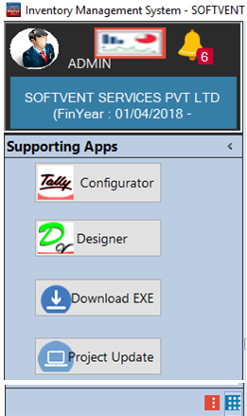
Supporting Apps
www.softvent.com

Slide 38
Thanking you
www.softvent.com

